Slide 1


Department of Computer Science and Engineering
SERVERLESS WEB APPLICATION
Dr. Murali Bhaskaran V
Dean(Academics)
B21A2425C18
Manthraa A (210701151)
Pradeep S (210701189)

Slide 2
Problem Statement and Motivation
Language difficulties make it difficult to communicate effectively in a variety of international contexts, which presents problems in humanitarian, educational, and professional contexts.
Real-time translation capabilities, scalability, and smooth integration are frequently absent from current options.
This project aims to leverage cutting-edge cloud technologies to enable real-time multilingual communication, fostering inclusivity and collaboration on a global scale.

Slide 3
Objectives
Design a serverless, real-time chat application with a scalable and cost-efficient architecture.
Integrate real-time translation for text, audio, and video communication to eliminate language barriers.
Improve accessibility by providing live captioning for audio and video calls, catering to users with hearing impairments.
Utilize AWS services to enhance performance, ensuring low latency and a smooth user experience.

Slide 4
Abstract
This project introduces a serverless, real-time chat application designed to overcome language barriers and promote global inclusivity. Utilizing AWS technologies, it incorporates API Gateway WebSocket for connection management, AWS Lambda for event-driven processing, and DynamoDB for optimized data handling. Key features include real-time message translation, live captioning for audio and video calls, and language transcription enabled by AWS Translate and Transcribe. The system facilitates seamless multilingual communication, making it indispensable for professional, educational, and humanitarian applications. Built for scalability and low latency, it reimagines effective and inclusive global communication.

Slide 5
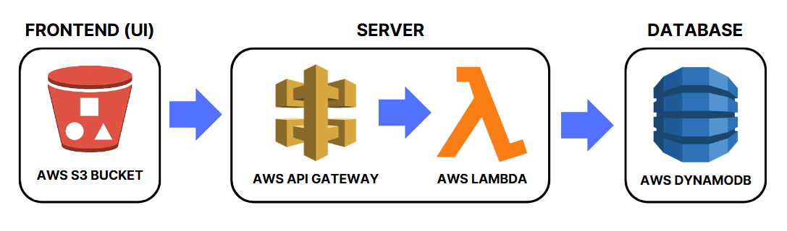
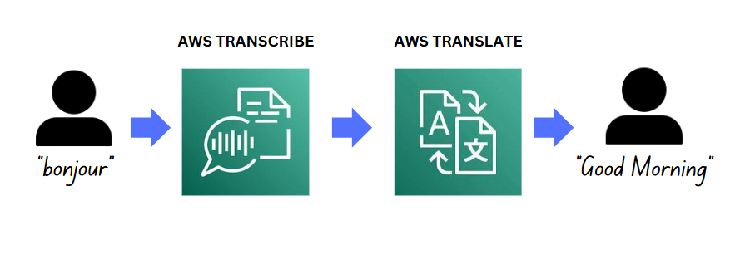
System Architecture

Slide 6
List of Modules
User Authentication and Profile Management
Real-Time Messaging
Audio and Video Communication
Transcription and Translation Module

Slide 7
User Authentication and Profile Management
This module handles secure user sign-up and login with Firebase Google Authentication, allowing users to log in using their Google accounts.
User details like name, email, and profile picture are stored in DynamoDB, along with language preferences for a personalized experience.
Firebase ensures session validation and secure access, eliminating manual credential handling and reducing unauthorized access risks.
Users can update profiles and preferences in real-time, providing seamless onboarding and secure interaction across the platform.

Slide 8
Real-Time Messaging
Facilitates real-time message exchange using AWS API Gateway WebSocket for persistent connections and AWS Lambda for processing.
Integrates AWS Translate to automatically convert messages into the recipient's preferred language, ensuring inclusive communication.
Stores translated messages in DynamoDB and retrieves chat history on demand for seamless user experience.
Provides low-latency messaging with notification support, enabling smooth and efficient interaction across diverse languages.

Slide 9
Audio and Video Communication
Enables users to initiate and participate in audio and video calls, ensuring high-quality transmission with minimal delays.
Uses AWS Transcribe to process audio streams and generate real-time captions, converting speech into text.
Translates captions into the user’s preferred language via AWS Translate, enhancing communication across languages.
Improves accessibility for users with hearing impairments or those speaking different languages, fostering inclusivity.
Securely stores session details, including captions, in DynamoDB for future access if needed, ensuring data reliability.

Slide 10
Transcription and Translation Module
Handles real-time transcription of audio content using AWS Transcribe and translation of text and captions via AWS Translate.
Integrates seamlessly with messaging and call functionalities for effective and uninterrupted communication.
Processes text inputs for instant translation and audio streams for live transcription, supporting multiple languages.
Displays translated outputs on the interface and securely stores them in DynamoDB for future reference.
Breaks linguistic barriers, enabling users to communicate effortlessly across diverse native languages.

Slide 11
Data Flow Diagram
User Authentication and Profile Management
Real-Time Messaging
Firebase
Authentication
User
Dynamo DB
AWS API Gateway WebSocket
AWS Lambda Process
AWS Translate
Dynamo DB
User

Slide 12
Data Flow Diagram
Audio and Video Communication
Transcription and Translation Module
Start Call Process
AWS Transcribe
AWS Translate
Dynamo DB
User
AWS Transcribe
AWS Translate
Dynamo DB
User

Slide 13
Implementation of First Module
Implemented Firebase Authentication for secure and seamless Google sign-in, ensuring reliable user login and session management.
Retrieved user details such as name, email, and profile picture, storing them securely in DynamoDB for persistence.
Enabled users to set and update language preferences and profile information, ensuring a personalized experience.
Synchronized user preferences and profile updates across devices for consistent functionality.
Integrated Firebase Auth with DynamoDB to manage sessions and maintain secure data storage across sessions.

Slide 14
Results of First Module
Successful Google sign-ins were achieved with seamless account creation and login.
User details and language preferences were accurately stored and retrieved from DynamoDB.
Profile management worked effectively, allowing users to update their details in real time.
The session management system ensured users stayed logged in, providing a smooth experience.
Overall, the module provided a secure, efficient, and personalized user experience.

Slide 15
Conclusion
The first phase of the serverless real-time chat application was successfully implemented, establishing a secure and scalable platform. Key features, such as User Authentication and Profile Management, were integrated using Firebase and DynamoDB, ensuring a smooth onboarding process and personalized user experiences. The Real-Time Messaging module was developed with AWS API Gateway and WebSocket, enabling seamless communication. Additionally, the initial setup of the Transcription and Translation module highlighted the application’s potential to break language barriers. Overall, the first phase demonstrated the feasibility of the project in facilitating global and inclusive communication.

Slide 16
Work for Phase II
Implement advanced message delivery mechanisms, such as read receipts and typing indicators.
Integrate WebRTC to support high-quality real-time video and audio calls.
Implement live transcription and captioning features for accessibility.
Optimize language translation to support more languages and reduce latency.

Slide 17
References
P. Kumar and Sheila Anand,”An Approach To Optimize Workflow Scheduling For Cloud Computing Environment”,Journal of Theoretical and Applied Information Technology,Vol.57,No 3,pp-617-623, 2013
Kumar P , Vinodh Kumar S , Priya L(2022), QoS based Classical Trust Management System for the Evaluation of the Trustworthiness of a Cloud Resource, Inventive Systems and Control, Lecture Notes in Networks and Systems, Springer, vol. 436, pp 323-344, ISSN 2367-3370, August 2022.
M. Roberts and M. Ward, "Building real-time applications on AWS: Leveraging Lambda and API Gateway for scalable messaging," IEEE Trans. Cloud Comput., vol. 10, no. 4, pp. 1156-1165, Nov. 2022.

Slide 18
References
A. Williams, "WebRTC and AWS Transcribe integration for real-time translation in serverless applications," IEEE Commun. Mag., vol. 58, no. 7, pp. 24- 31, July 2021.
S. Ramirez and L. Gupta, "Exploring serverless architectures in cloud computing: The case of AWS for real-time data processing," IEEE Access, vol. 8, pp. 75434-75446, June 2020.
Y. Zhang, K. Lee, and H. Kim, "Database optimizations for serverless applications on AWS: A study on DynamoDB efficiency," IEEE Trans. Cloud Comput., vol. 12, no. 3, pp. 941-952, Mar. 2023.

Slide 19
Paper Publication Status
TITLE: Serverless real time chat web application with automated language translation
AUTHOR: Dr. V. Murali Bhaskaran M.E., Ph.D.,
Dr. P. Kumar M.E., Ph.D.,
Manthraa A
Pradeep S
STATUS: Yet to Publish

Slide 20
Thank You

